Slide 1

Live a Green Life in NYC
—Shiny App Development Version 2.0
Group 5
Team: Xin Xia, Yiyao Hu, Zixiao Wang

Slide 2




Value Added of the Improved App
For people who would like to find a living place where the air quality is better, we added a function in the app which provides the comparison of the median housing rental prices versus air quality. In this way, people are able to find a place with a higher price-performance ratio.

Slide 3
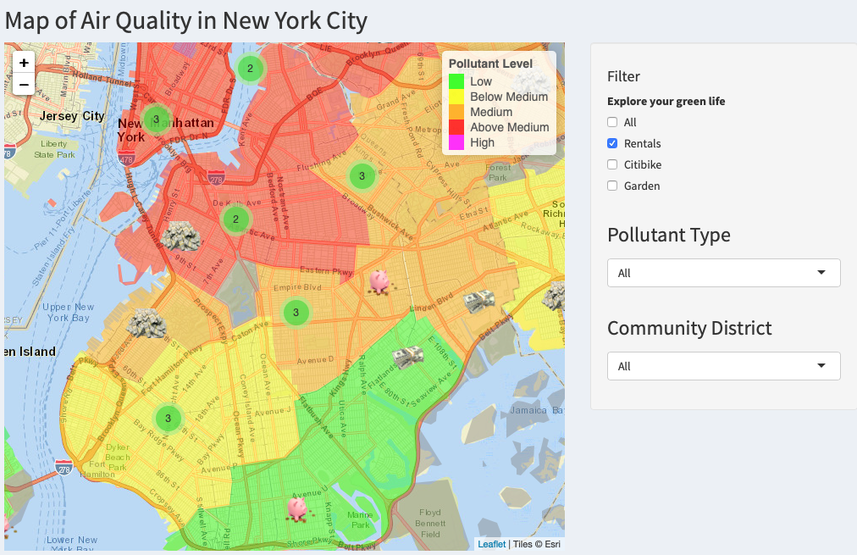
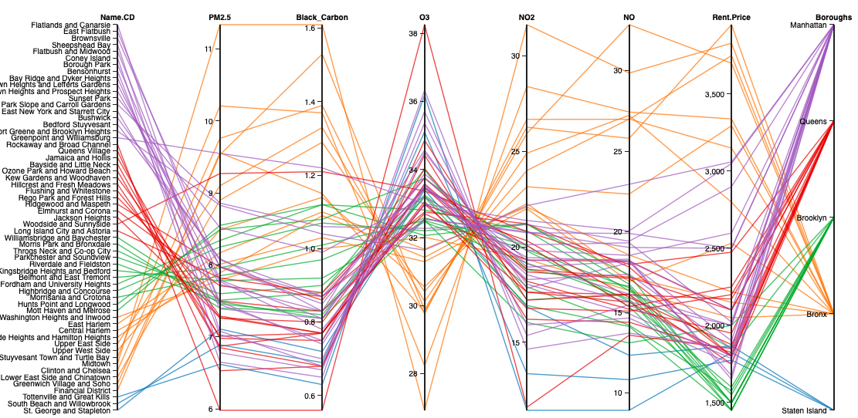
Enjoy your housing exploring!

Slide 4
Implementation of the App
In order to increase the ability of comparison of the app, we create several comparison plots to reach the goal. For example, we combined the air quality components and the New York city map, which will give us a more clear view on which part in NYC would be more suitable for people to choose citi bike as their travel method. We also achieved using one radar chart to compare the air quality components in two community districts.

Slide 5
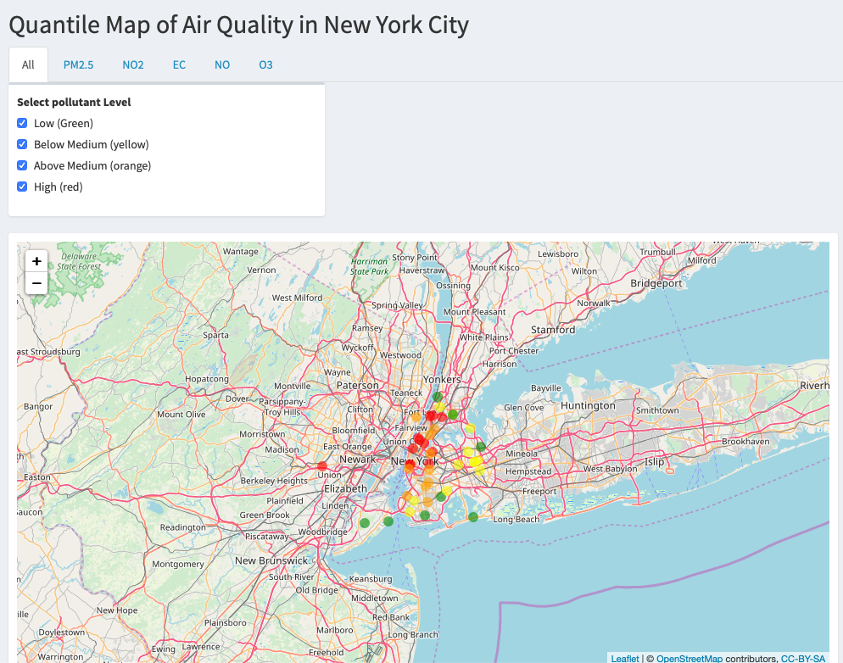
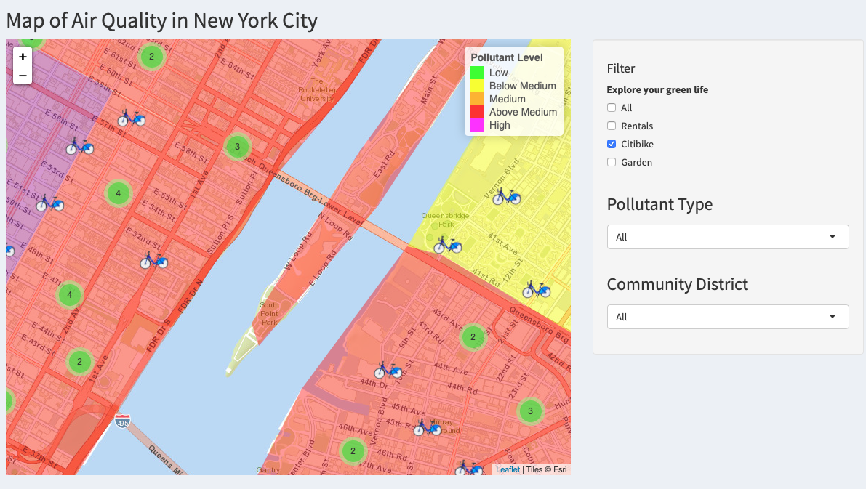
Separated Combined

Slide 6
Visualization
In order to increase the value of each plot, we tried to make more adjustable functions to each plot. For instance, we updated the spider plot to a new one, which could compare two different community districts. Also, we make adjustable bins to histogram which would give people more information related to the air quality index.

Slide 7
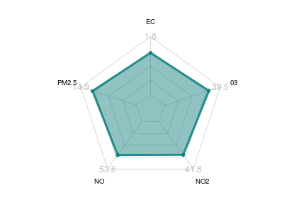
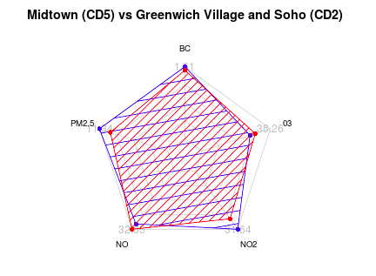
Comparison provides you with a better decision.

Slide 8
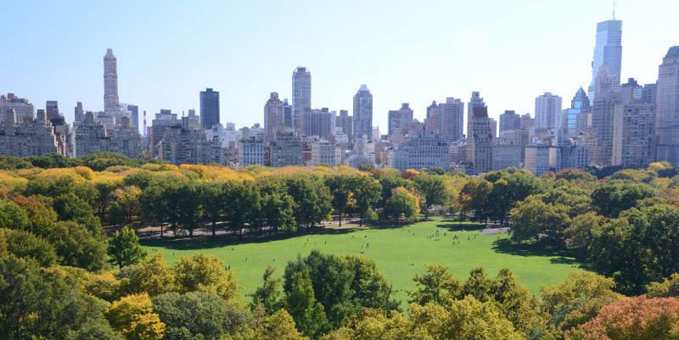
Let go to the app and be happy with searching!
https://sheenxia.shinyapps.io/Greenlife/

